Slide 1

MTHM017 Advanced Topics Workshop C
Dr John T Bruun

Slide 2
Workshop Task
This and next week we are looking at Machine Learning algorithms.
In this practical we will cover the following topics:
* Logistic regression
The examples we run use the R package and also some calculations in Python. You will need Python loaded (e.g. via Anaconda / Spyder) to run the latter calculations. The CEMPS Digital Learning Developers can help you if you have any specific install questions (MathsDLD@exeter.ac.uk).
Machine learning methods enable systematic evaluation techniques to be applied to large data. They help to reveal the underlying groupings that exist in data that otherwise can look noisy and unstructured.
With this task you have the Rmarkdown script to evaluate the classifier. There is also a Python script where you can gain familiarity with running this (you can do the whole of this task with R).

Slide 3
Workshop Task
You have been given the data from a large scale study of breast cancer tumors and the severity of them for each (anonymised) person.
The data you have been given consists of 30 explanatory variables (different measurements of the tumor), and the label indicating whether the tumor is benign or malignant.
With such a model this can give a diagnosis tool to help identify risk during subsequent medical practice.
The task you have is to Build a classifier of breast cancer malignancy.
The data you have includes classification of tumours as being benign (0) or malignant (1).
To test the model efficacy, since we only have one dataset, to test model performance create a ‘hold-out’ sample and develop the model on the remaining training data set.
To do this randomly split to data, and build the model on 75% of available, and test the model on the remaining 25%. Once you are happy with this result – alter the training set size to 65% and 85% and assess how robust the classifier results are.

Slide 4
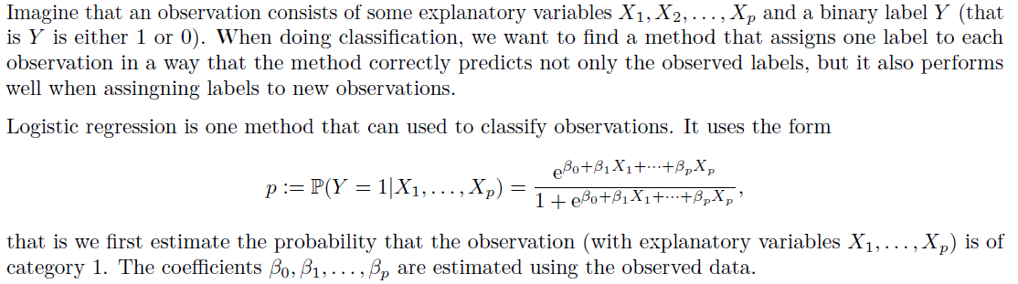
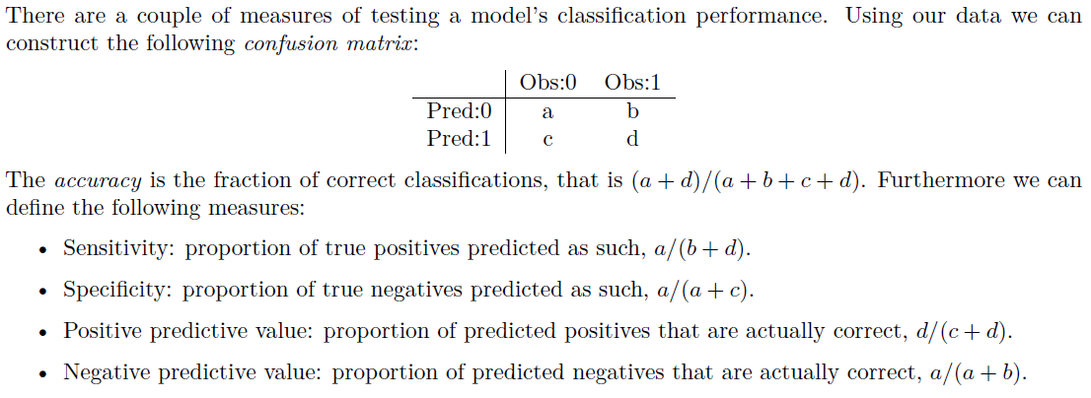
Logistic classification

Slide 5
Workshop Task
The task you have is to Build a classifier of breast cancer malignancy.
Breakout into teams of about 6. You have an hour, and then report back.
There is a lot to run and assess. Create team pairs of investigators to look at the following:
Number of variables: Explore the performance of the classifier by varying the number of variables V1, … V30 used in the logistic regression function.
Training data set size: To test the model efficacy, since we only have one dataset, to test model performance create a ‘hold-out’ sample and develop the model on the remaining training data set. To do this randomly split to data, and build the model on {65%, 75%, 85%} of available, and test the model on the remaining {35%, 25%, 15%}.
Outcome:
Put together a table of results explaining the confusion matrix / accuracy results.
With this table jointly produce a 1 – page summary in a form suitable to explain the results to a medical clinician. How well does it work and what are any limitations?

